Slide 1

Data Rectangle Transformation

Slide 2
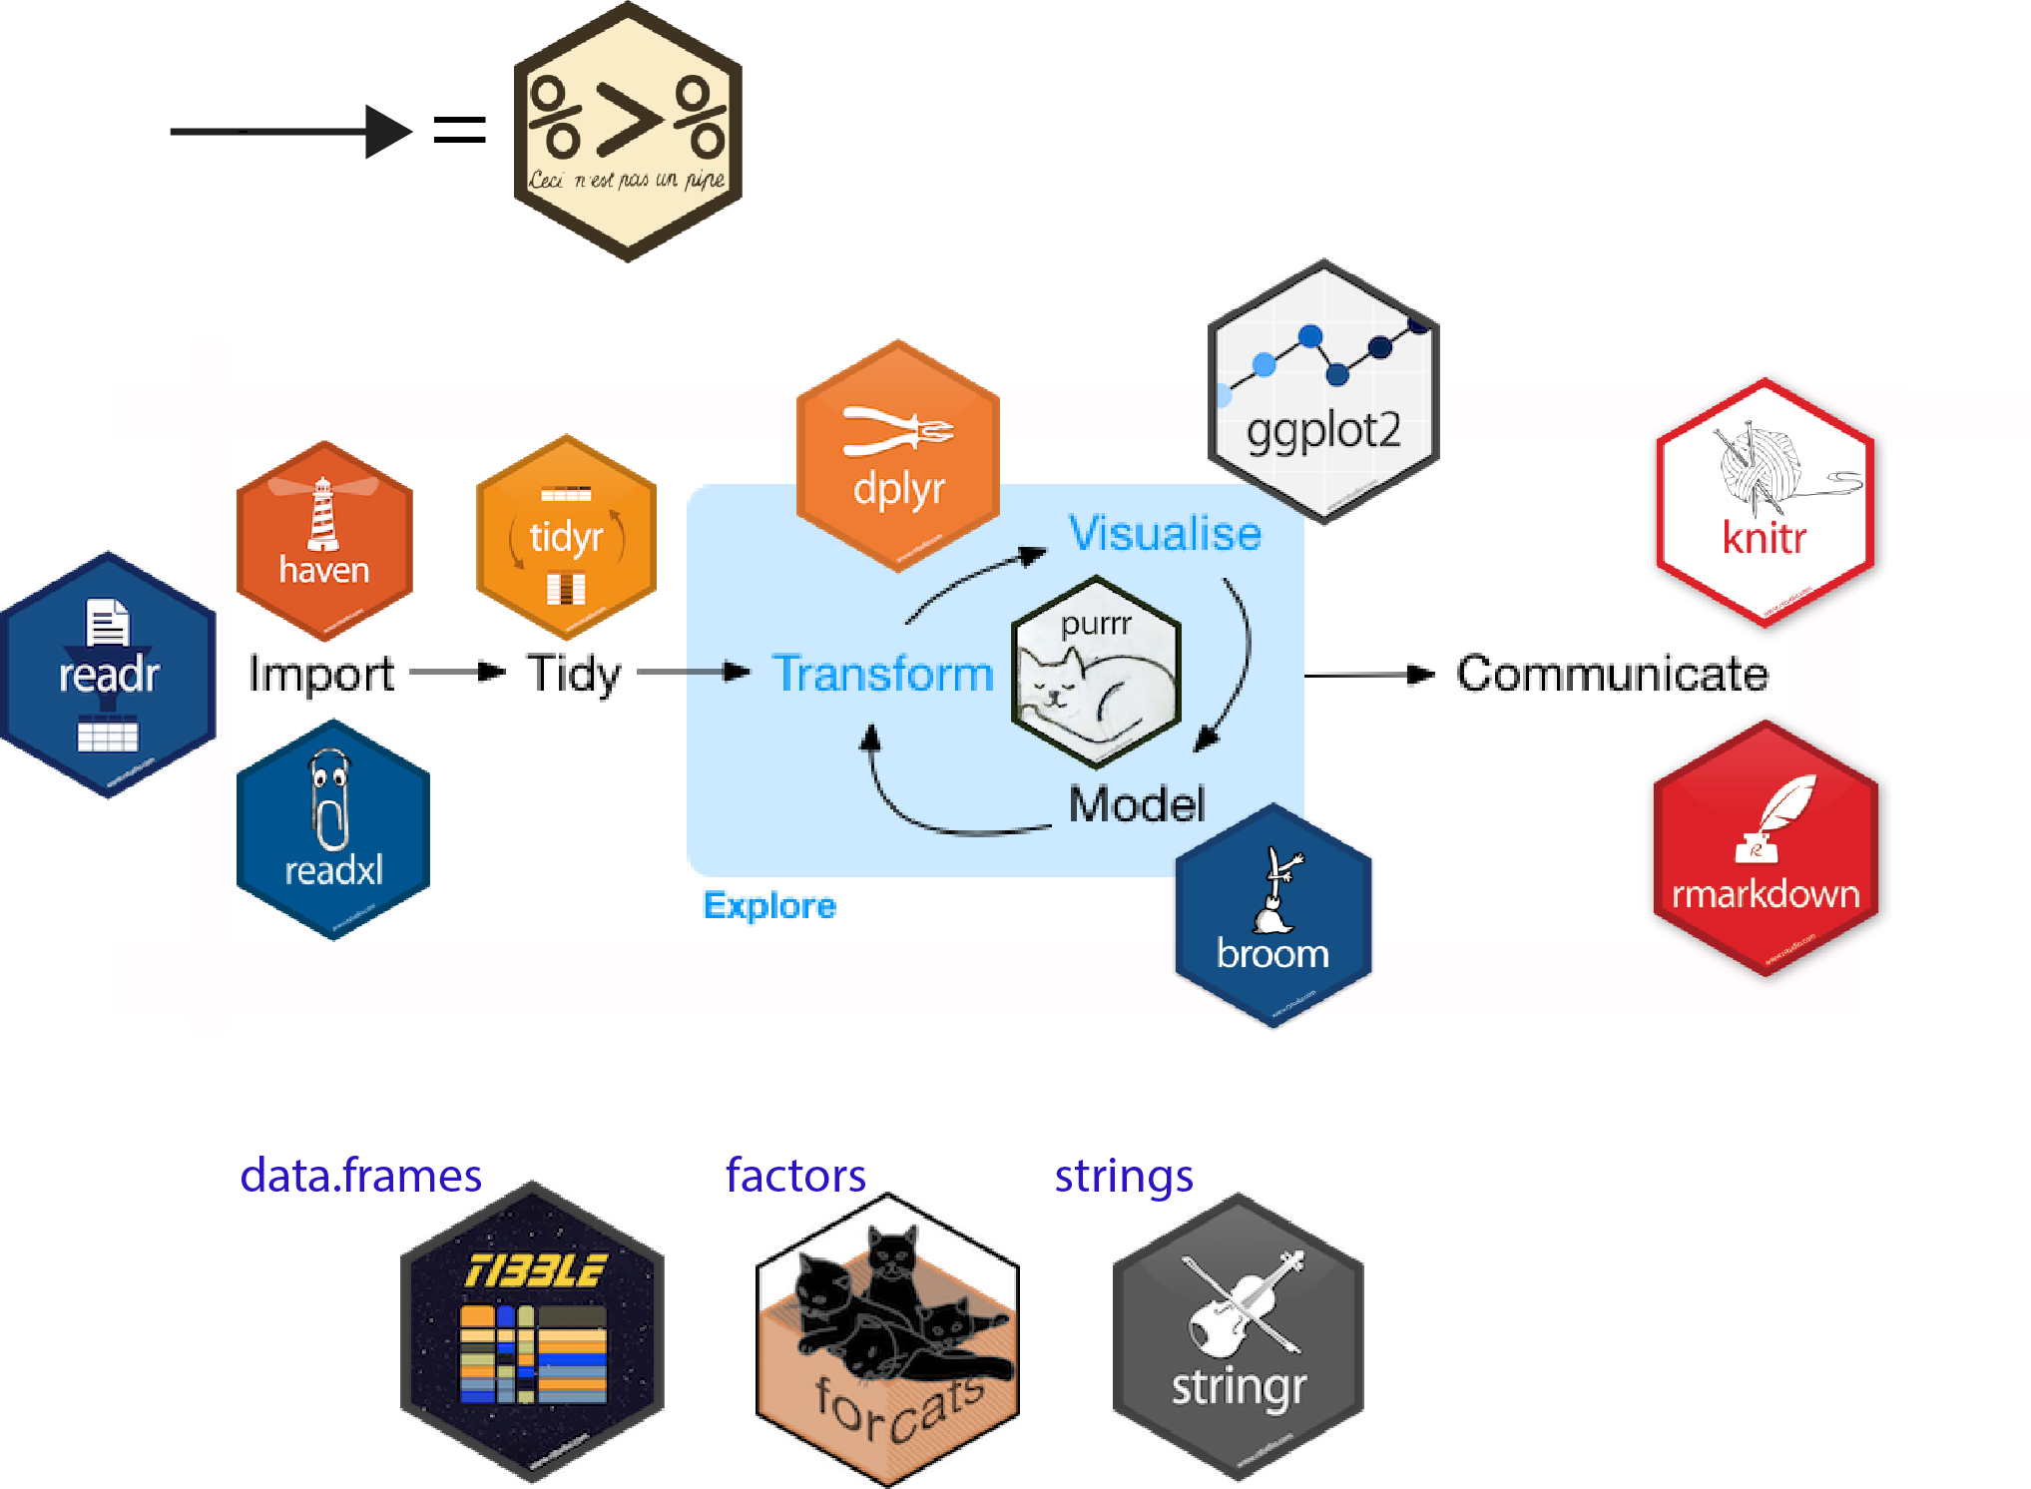

Transform!

Slide 3
Data pivoting… in Excel
Table
Wide
Fat
Tall
Tidy
List
?
Pivot Table

Slide 4
More complex pivoting in Excel?
?
?

Slide 5

Data pivoting, the R way

Slide 6
Data pivoting, the R way
spread
pivot_wider
pivot_longer
gather

Slide 7
Mini test
pivot_longer
pivot_wider

Slide 8
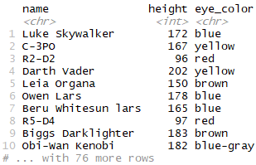
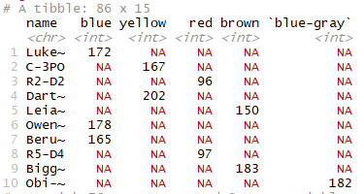
Mini test2
pivot_longer
pivot_wider

Slide 9

Live Code

Slide 10

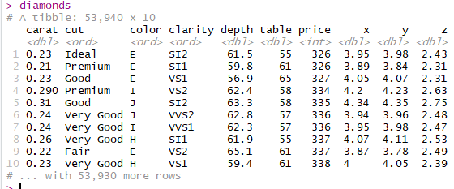
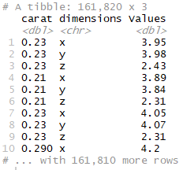
Pivot_longering exercise!
Organize these steps
8 diamonds %>%
4 select(carat, x, y, z) %>%
5 pivot_longer(
1 data = .,
2 cols = x:z,
6 names_to = "dimensions",
3 values_to = "Values"
7 )
1 data = .,
2 cols = x:z,
3 values_to = "Values"
4 select(carat, x, y, z) %>%
5 pivot_longer(
6 names_to = "dimensions",
)
8 diamonds %>%

Slide 11
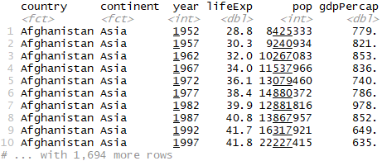
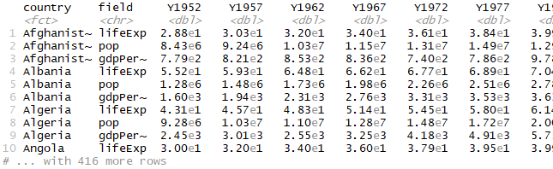
Repivot LiveCode– gapminder!

Slide 12
Repivot question
To get from one table format to another type of table format, we must:
pivot_longer and then pivot_longer
pivot_wider and then pivot_longer
pivot_longer and then pivot_wider
Use Excel

